Slide 1
Story Boarding
BTEC Creative Media Production (level 2)

Slide 2
What is a storyboard
What is a storyboard?
Once a concept or script is written for a film or animation, the next step is to make a storyboard.
A storyboard visually tells the story of a film panel by panel, like a comic book.
Your storyboard should convey some of the following information:
What characters are in the frame, and how are they moving?
What are the characters saying to each other, if anything?
What sound effects, background music, etc. will be used. (Remember audio is a very powerful tool and can really change the mood of a scene.)
How much time has passed between the last frame of the storyboard and the current one?
Where the "camera" is in the scene? Close or far away? Is the camera moving?

Slide 3
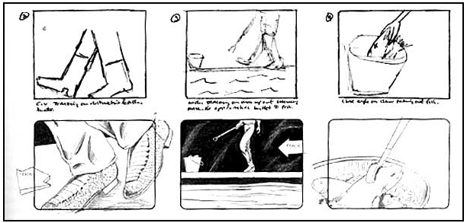
Why make a storyboard?
Creating a storyboard will help you plan your animation out shot by shot.
You can make changes to your storyboard before you start animating/filming, instead of changing your mind later.
You will also be able to talk about your animation/film and show your storyboard to other people to get feedback on your ideas.

Slide 4
How do I make a storyboard?
Most commonly, storyboards are drawn in pen or pencil. If you don't like to draw you can also take photos, cut out pictures from magazines, or use a computer to make your storyboards.
Keep in mind that your drawings don't have to be fancy!
In fact, you want to spend just a few minutes drawing each frame.
Use basic shapes, stick figures, and simple backgrounds.
If you draw your storyboard frames on index cards, you can rearrange them to move parts of the the story around.

Slide 5
Storyboard Language
CLOSE-UP SHOT: A close range of distance between the camera and the subject.
DISSOVLE: A transition between two shots, where one shot fades away and simultaneously another shot fades in.
FADE: A transition from a shot to black where the image gradually becomes darker is a Fade Out; or from black where the image gradually becomes brighter is a Fade In.
HIGH CAMERA ANGLE: A camera angle which looks down on its subject making it look small, weak or unimportant.

Slide 6
Storyboard Language
JUMP CUT: A rapid, jerky transition from one frame to the next, either disrupting the flow of time or movement within a scene or making an abrupt transition from one scene to another.
LEVEL CAMERA ANGLE: A camera angle which is even with the subject; it may be used as a neutral shot.
LONG SHOT: A long range of distance between the camera and the subject, often providing a broader range of the setting.
LOW CAMERA ANGLE: A camera angle which looks up at its subject; it makes the subject seem important and powerful.

Slide 7
Storyboard Language
PAN: A steady, sweeping movement from one point in a scene to another.
POV (point of view shot): A shot which is understood to be seen from the point of view of a character within the scene.
REACTION SHOT-
1: A shot of someone looking off screen.
2: A reaction shot can also be a shot of someone in a conversation where they are not given a line of dialogue but are just listening to the other person speak.
TILT: Using a camera on a tripod, the camera moves up or down to follow the action.
ZOOM: Use of the camera lens to move closely towards the subject.

Slide 8
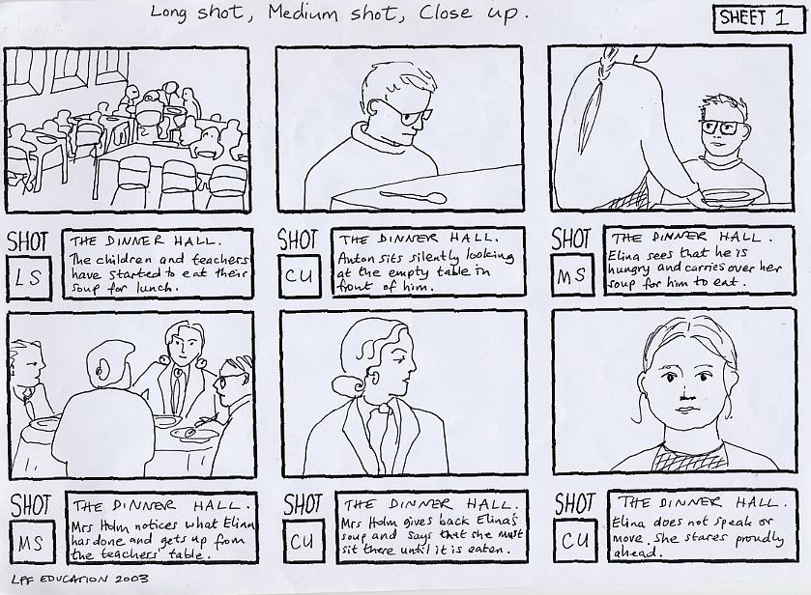
example

